Slide 1

密度矩阵重整化群方法

Slide 2
Outline
Density Matrix Renormalization Method
Applications of DMRG method in Heisenberg model

Slide 3
Problems in Quantum Many-Body system:
1D Heisenberg model:
Numerical methods suffer various intractable troubles, which are mainly because that the Hilbert space grows exponentially with the size of the system.
# of Spin # of basis Hilbert Space Dims
1 2
2 2²
… … …
16 2¹⁶
… … …
32 2³²
L ~ 10²³ exp(Lln2)
Exponential Wall Problem

Slide 4
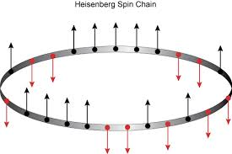


Short Introduction to DMRG
From ED
To DMRG
把指数增长的问题转化成线性增长的问题
Non-polynomial （NP） ⇒ Polynomial problem
Exact diagonalization (ED)
Density-matrix RG (DMRG)
Matrix product state:
Hilbert space Dim:
Hilbert space Dim:
Computation cost:
Computation cost:
Advt: Exact
Advt: Numerical exact in 1D.
disAdvt: small size L<48
disAdvt: 2D challenging

Slide 5
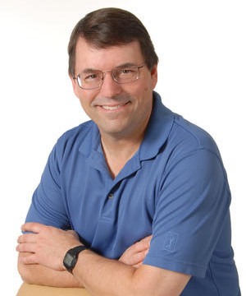
Short Introduction to DMRG
The Density Matrix Renormalization Group (DMRG) is a numerical variational technique devised to obtain the low-energy physics of quantum many-body systems with high accuracy. It was invented in 1992 by Steven R. White and it is nowadays the most efficient method for 1-dimensional systems.
Steven R. White

Slide 6
The Exact Diagonalization Method
Eigenvalue problem of symmetric matrix :

Slide 7
The Exact Diagonalization Method
Eigenvalue problem of symmetric matrix :
Lanczos的天才发现是，在不断生成希尔伯特新的正交基的迭代过程中，每一步迭
代只需要近邻的前两个修正项，这就是著名的三项递推式。

Slide 8
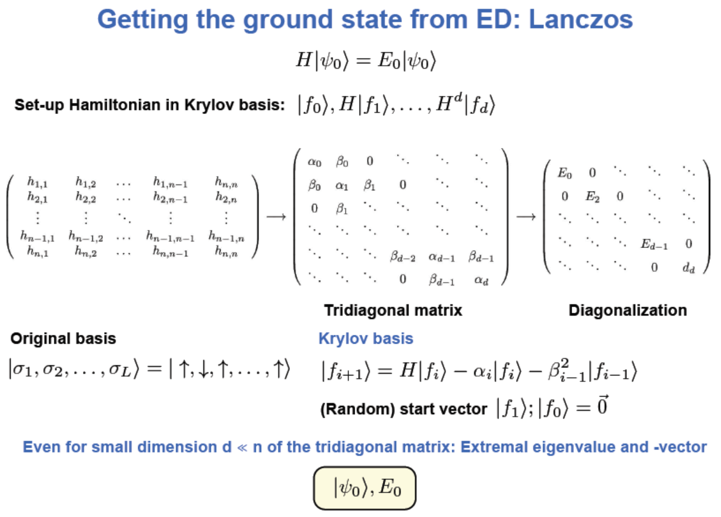
The Exact Diagonalization Method

Slide 10
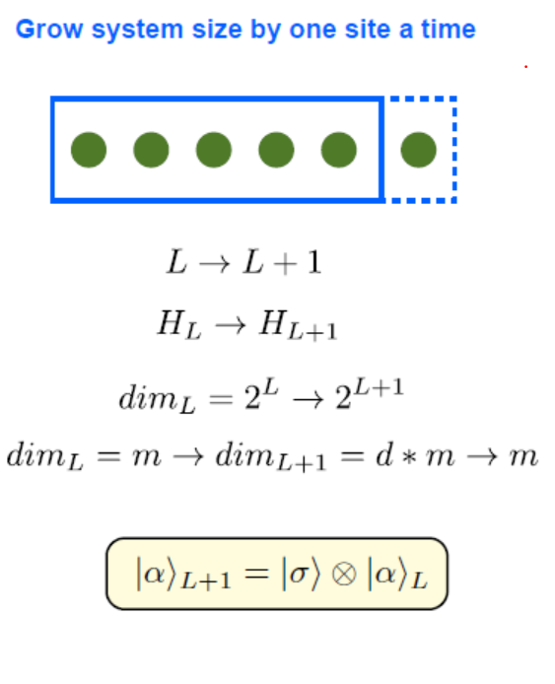
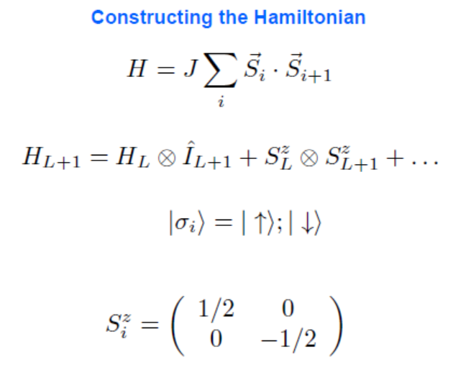
Hilbert-space decimation techniques

Slide 11
Hilbert-space decimation techniques

Slide 12
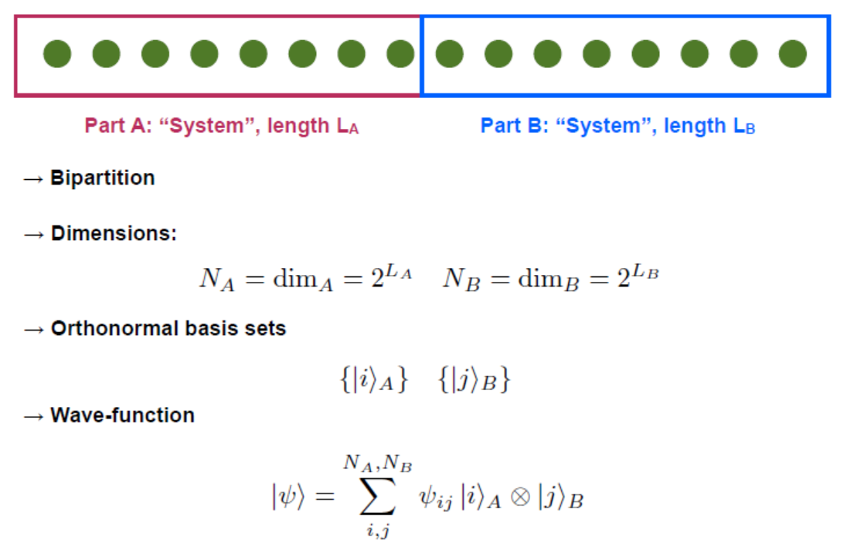
Hilbert-space decimation techniques

Slide 13
Hilbert-space decimation techniques

Slide 14
Hilbert-space decimation techniques

Slide 15
Hilbert-space decimation techniques

Slide 16
Hilbert-space decimation techniques

Slide 17
Hilbert-space decimation techniques

Slide 18
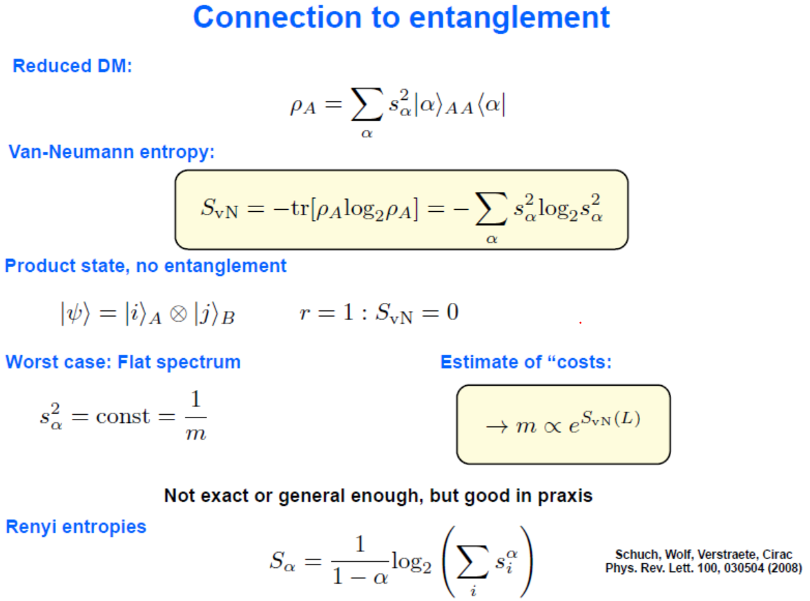
Entanglement entropy and Entanglement scaling

Slide 19
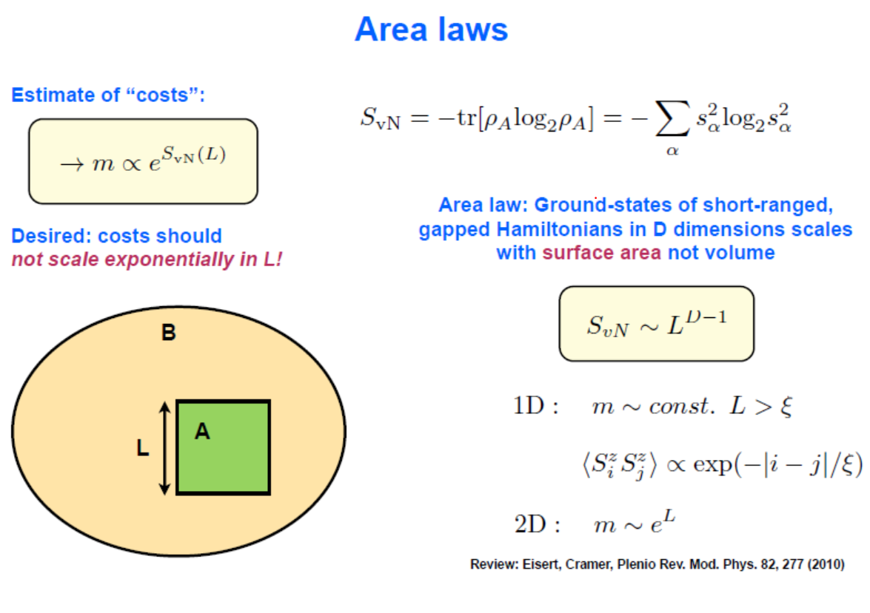
2.3. Entanglement entropy and Entanglement scaling

Slide 20
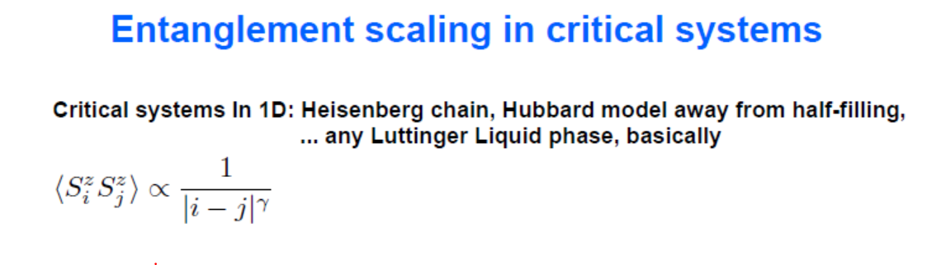
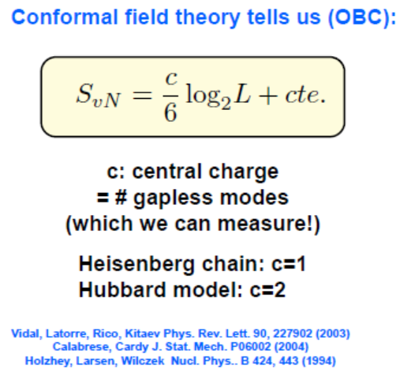
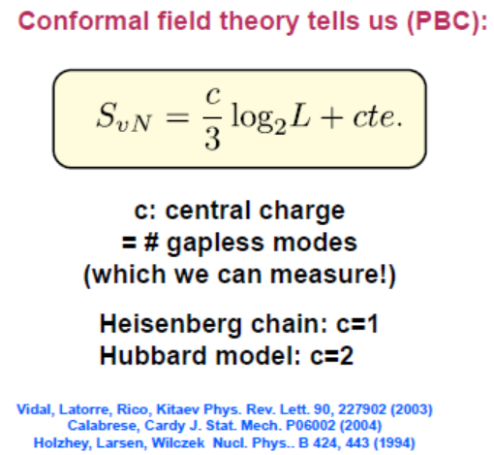
2.3. Entanglement entropy and Entanglement scaling

Slide 21
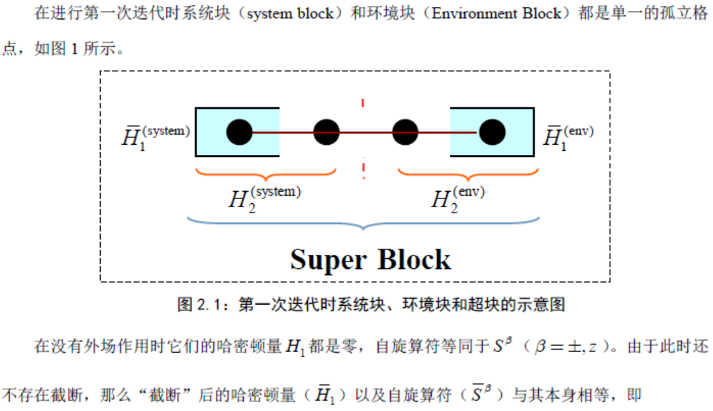

The DMRG Method
第一次迭代步骤

Slide 22
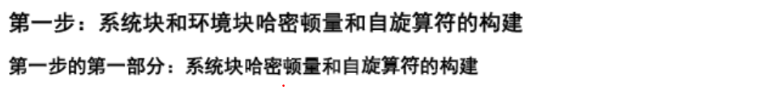
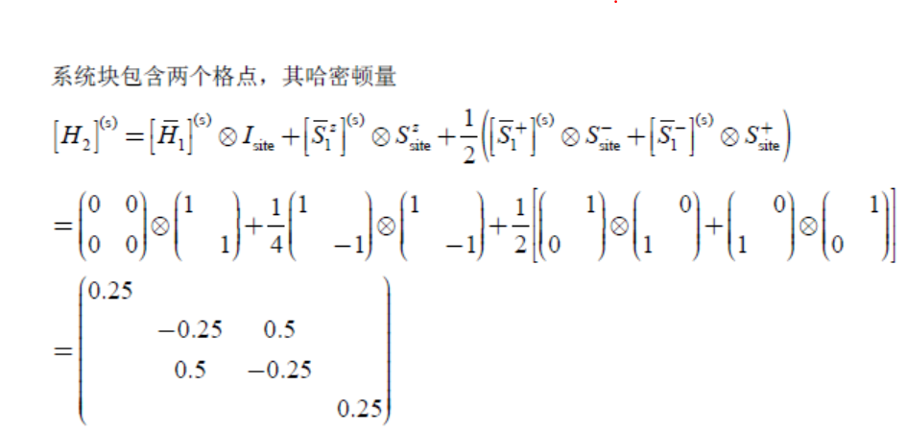
The DMRG Method
第一次迭代步骤

Slide 23
The DMRG Method

Slide 24
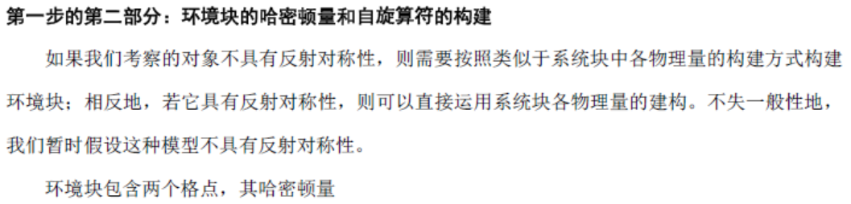
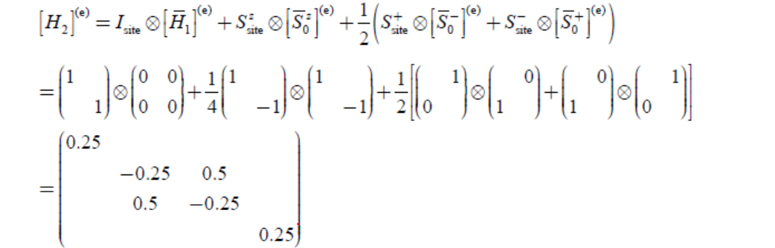
The DMRG Method
第一次迭代步骤

Slide 25
The DMRG Method

Slide 26
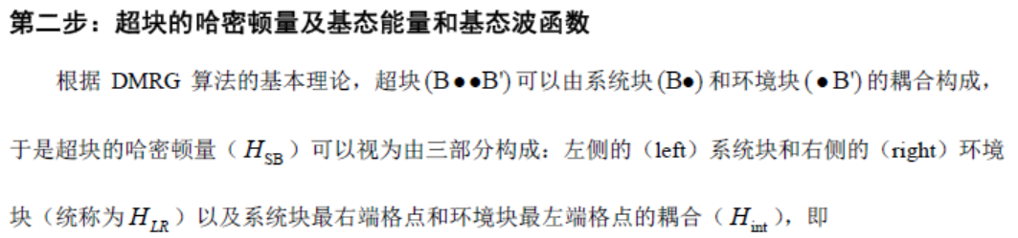
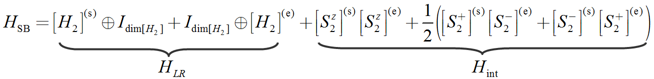
The DMRG Method
第一次迭代步骤

Slide 27
The DMRG Method

Slide 28
The DMRG Method

Slide 29
The DMRG Method

Slide 30
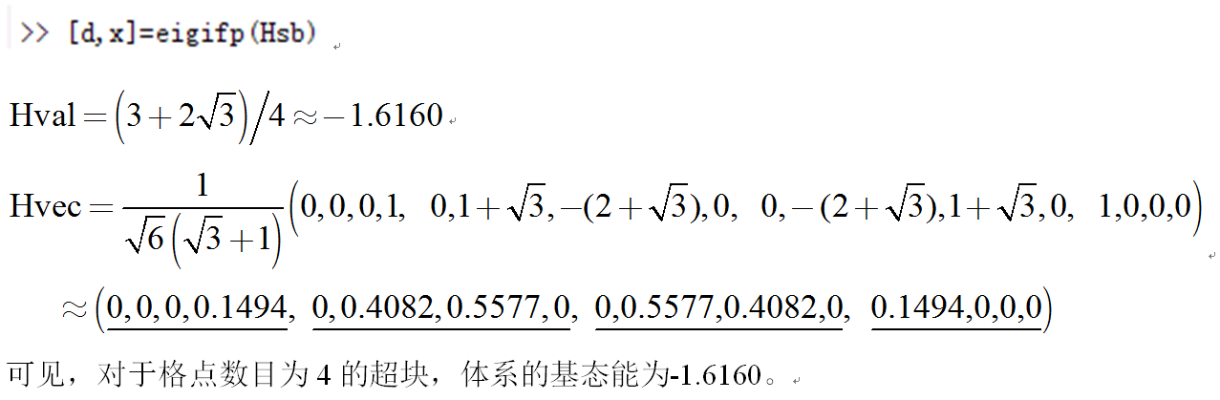
The DMRG Method
第一次迭代步骤
一旦我们得到了超块哈密顿量的矩阵表示，通过调用标准的对角化方法便可求得超块的基态能量和基态波函数。鉴于超块的尺寸会随着格点数目的增大而以指数的形式急剧增加，且超块的哈密顿量是稀疏矩阵。这里比较推崇的用来求解大型稀疏矩阵本征值的方法是Lanczos方法和Davidson/Arnoldi方法。
本世纪初G. Golub和Q. Ye等人在这两种方法的基础上发展出了一个新的Krylov子空间射影方法，它可以非常高效地求解广义本征值问题，这种被称为inverse free preconditioned方法已经被置入MATLAB作为eigifp函数直接调用。
运用函数eigifp可知超块哈密顿量的最小本征值和本征矢为

Slide 31
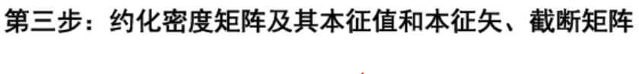
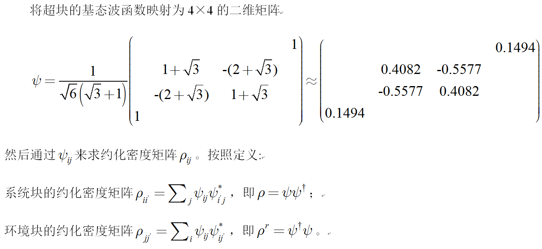
The DMRG Method
第一次迭代步骤

Slide 32
The DMRG Method

Slide 33
The DMRG Method

Slide 34
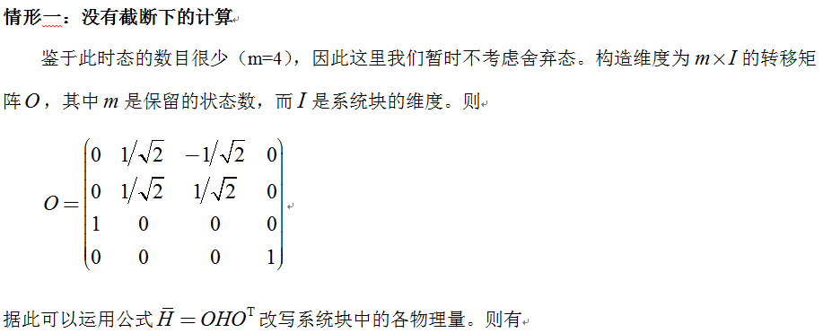
2.4. The DMRG Method
第一次迭代步骤

Slide 35
The DMRG Method

Slide 36
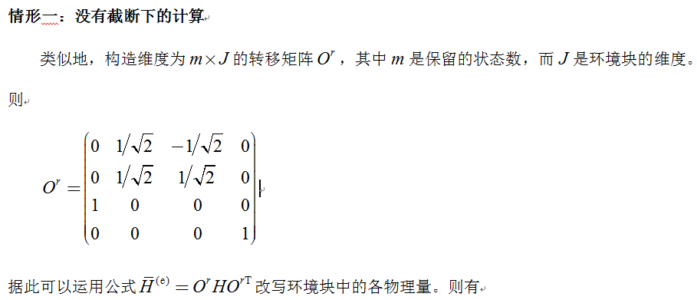
2.4. The DMRG Method
第一次迭代步骤

Slide 37
The DMRG Method

Slide 38
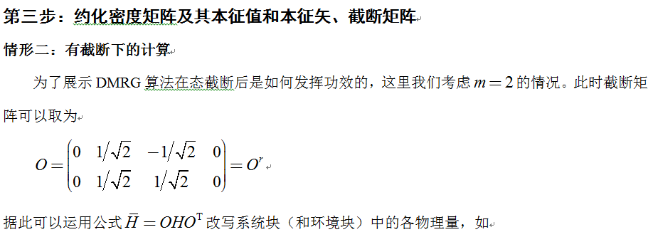
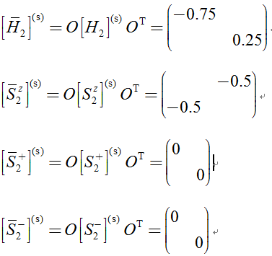
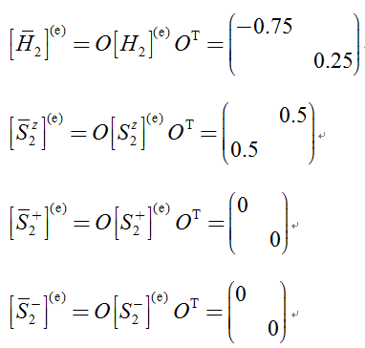
2.4. The DMRG Method
第一次迭代步骤

Slide 39
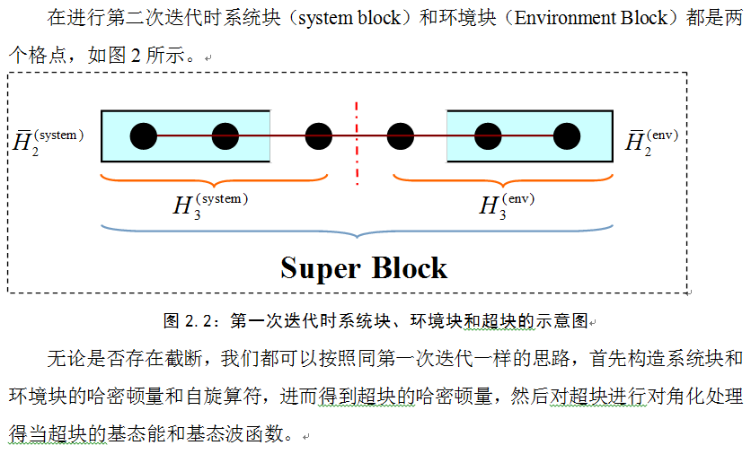
2.4. The DMRG Method
第二次迭代步骤

Slide 40
2.4. The DMRG Method
第二次迭代步骤
在没有截断的情况下，超块的哈密顿量是64×64的矩阵，此时超块的基态能为-2.4936。
在 有 截断的情况下，超块的哈密顿量是16×16的矩阵，此时超块的基态能为-2.3124。
可见，在有截断误差的情况下得到的基态能是大于真实的基态能的（变分原理）。可以预见，这种差异会随着保留态的增多而减小。通常情况下，对于自旋S=1/2的海森堡模型，我们保留100个态就可以达到令人满意的精度。对于自旋S>1/2的情况以及体系存在长程相互作用时，需要保留的态会增大很多。

Slide 41
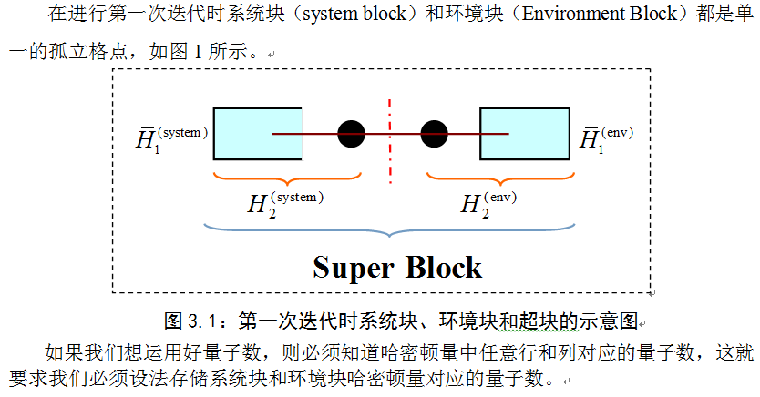
2.5. The DMRG Method – U1(2) symmetry
第一次迭代步骤

Slide 42
The DMRG Method

Slide 43
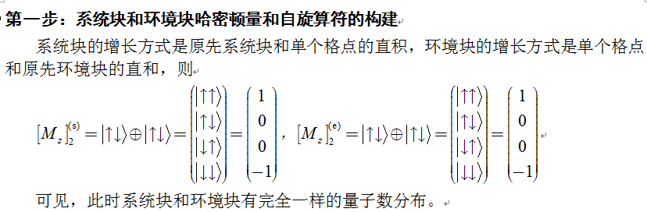
2.5. The DMRG Method – U1(2) symmetry
第一次迭代步骤

Slide 44
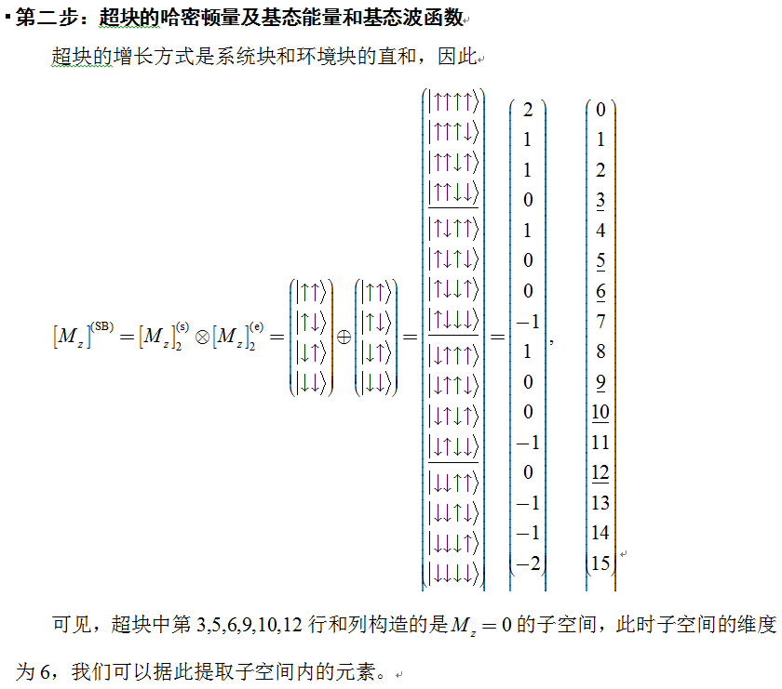
2.5. The DMRG Method – U1(2) symmetry
第一次迭代步骤

Slide 45
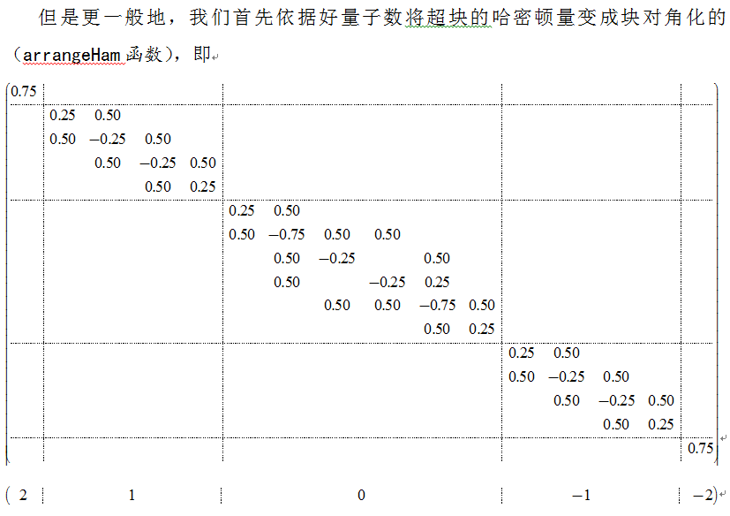
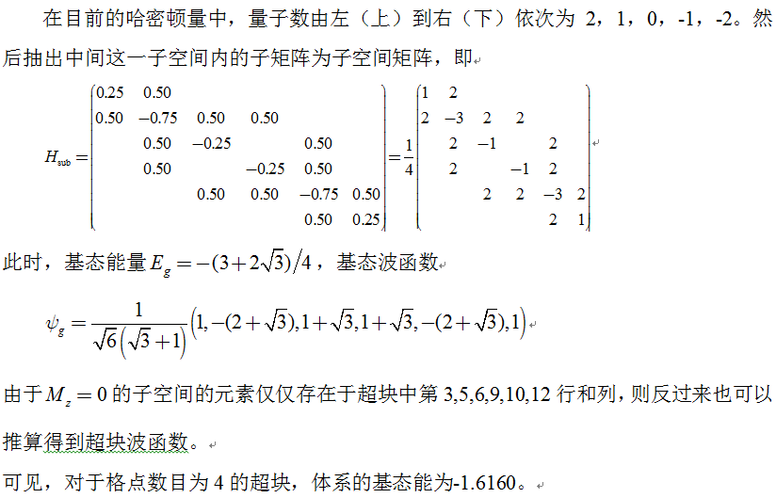
2.5. The DMRG Method – U1(2) symmetry
第一次迭代步骤

Slide 46
2.5. The DMRG Method – U1(2) symmetry
第二次迭代步骤

Slide 47
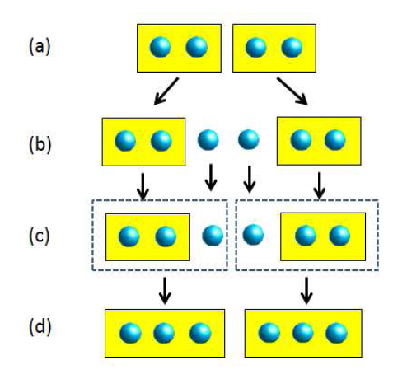
DMRG: The Algorithm
How do we build the reduced basis of states?
We grow our basis systematically, adding sites to our system at each step, and using the density matrix projection to truncate

Slide 48
The Algorithm

Slide 50
The DMRG Method

Slide 51
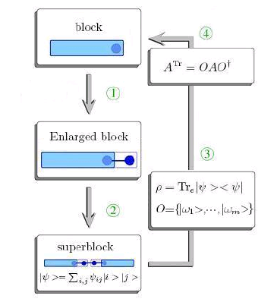

Slide 52
The DMRG Method

Slide 53

The finite size algorithm
We add one site at a time, until we reach the desired system size
1
2
3
4

Slide 54
The finite size algorithm
We sweep from right to left
We sweep from left to right
1
1
1
4
4
4
4
4
4
4
4
4
4
4
2
3
1
4
1
4
1
1
1
1
1
1
1
2
1
2
2
2
2
2
2
3
2
3
3
3
2
3
3
3
3
3
3
2
3
2
2
3
…Until we converge

Slide 55
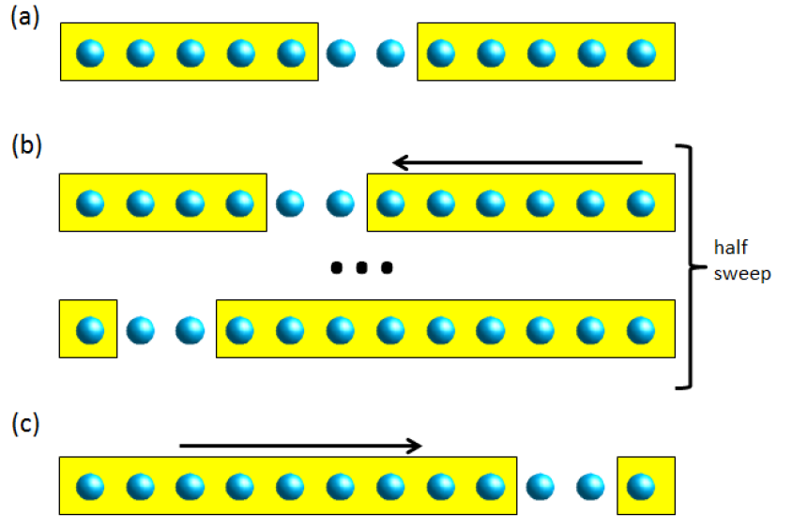
Finite-size DMRG Flow chart

Slide 56
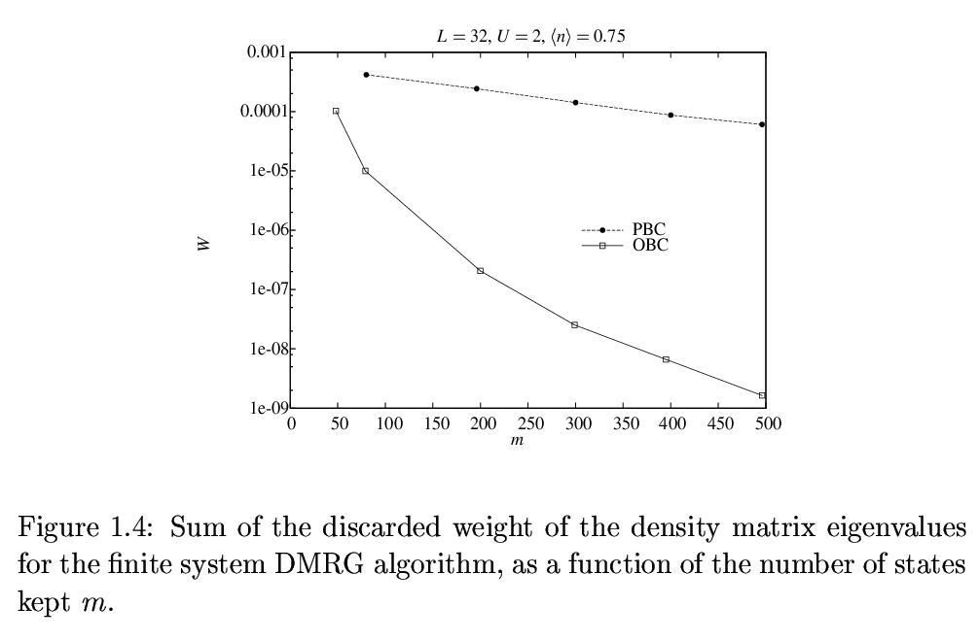
The discarded weight 1- ∑^{m}_{α=1}ω_{α} measures the accuracy of the truncation to m states

Slide 57
Observations
Sweeping is essential to achieve convergence
Run the finite-size DMRG and extrapolate to the thermodynamic limit.
For each system size, extrapolate the results with the number of states m, or fix the truncation error below certain tolerance.

Slide 58
Density Matrix Renormalization Group
A variational method without a-priori assumptions about the physics.
Similar capabilities as exact diagonalization.
Can calculate properties of very large systems (1D and quasi-2D) with unprecedented accuracy.
Results are variational, but “quasi-exact”: Accuracy is finite, but under control.

Slide 59
Advantages of the DMRG
DMRG is very versatile, and easy to adapt to complex geometries and Hamiltonians.
Can be used to study models of spins, bosons, or fermions.
General and reusable code: A single program can be used to run arbitrary models without changing a single line (e.g. ALPS DMRG)
Symmetries are easy to implement.
Notes:
59

Slide 60
Limitations of the DMRG
DMRG is the method of choice in 1d and quasi-1d systems, but it is less efficient in higher dimensions.
Problems with (i) critical systems, (ii) long range interactions, and (iii) periodic boundary conditions.
These limitations are due to:
The structure of the variational wave function used by the DMRG (the MPS ansatz).
Entanglement entropy follows area law.
Notes:
60

Slide 61
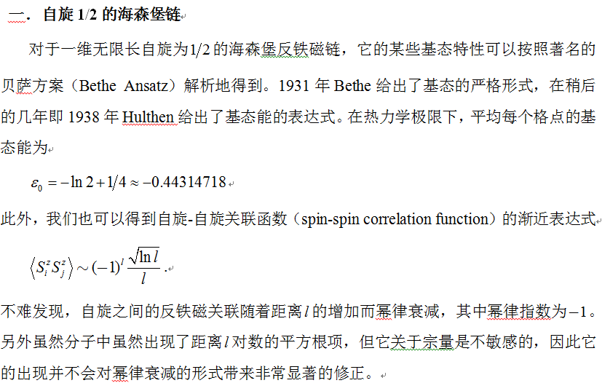
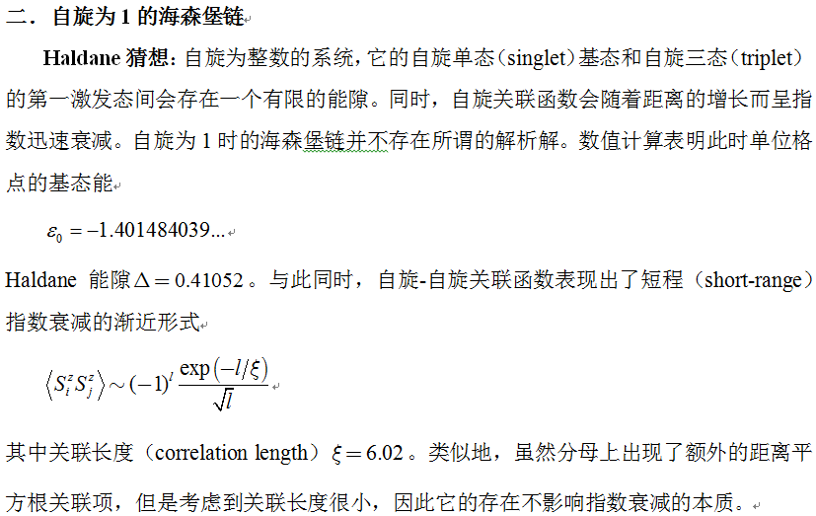
3. The DMRG Method
Heisenberg模型

Slide 62
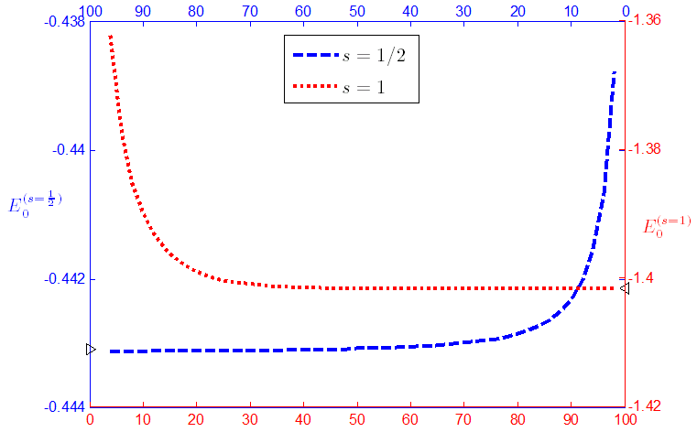
基态能量比较

Slide 63
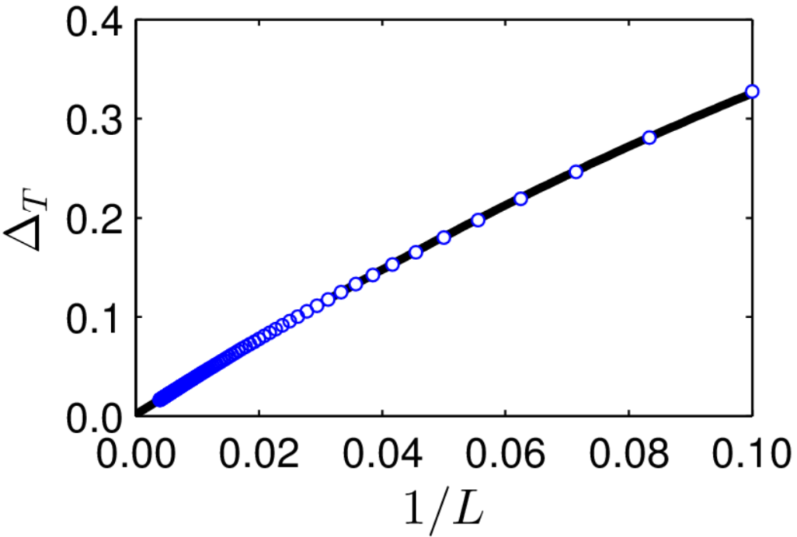
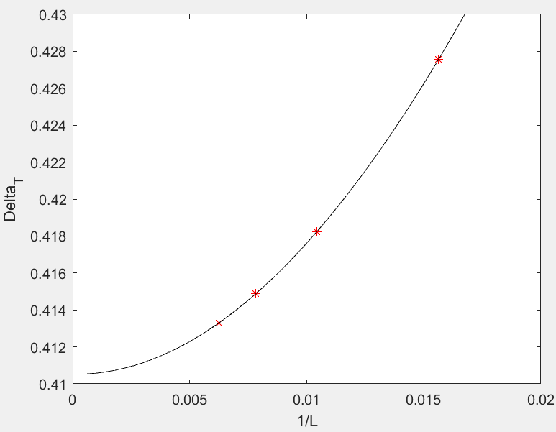
基态能隙比较
Comparison for 1D S=1 Heisenberg model
Methods ground state energy energy gap
QMC -1.4015(5) 0.41
Lanczos -1.40148(2) 0.41049(2)
DMRG -1.401484038971(4) 0.41050(2)

Slide 64

谢谢大家！

